Slide 1
Causes and Patterns of Cell Injury & Necrosis By
Dr. Alia Mohammed Khudier

Slide 2
A variety of changes in cell morphology and function in response to injury.
Injuries often induce changes in cellular structure which are not lethal and are reversible. These changes include
swelling, hydropic change, and fatty change.
1- Acute cellular swelling (Figures 1 through 6)
a. Cells swell due to increased water uptake following alterations in membrane permeability.

Slide 3
b. Cytoplasm develops a “ground glass” appearance primarily due to fine, watery vacuoles in the cytosol and mitochondria.
c. Mitochondria are very exposed to noxious agents; if damaged, cellular metabolism (ionic pump) fails yielding osmotic swelling of the organelle.
** Seen typically in epithelial cells.

Slide 4
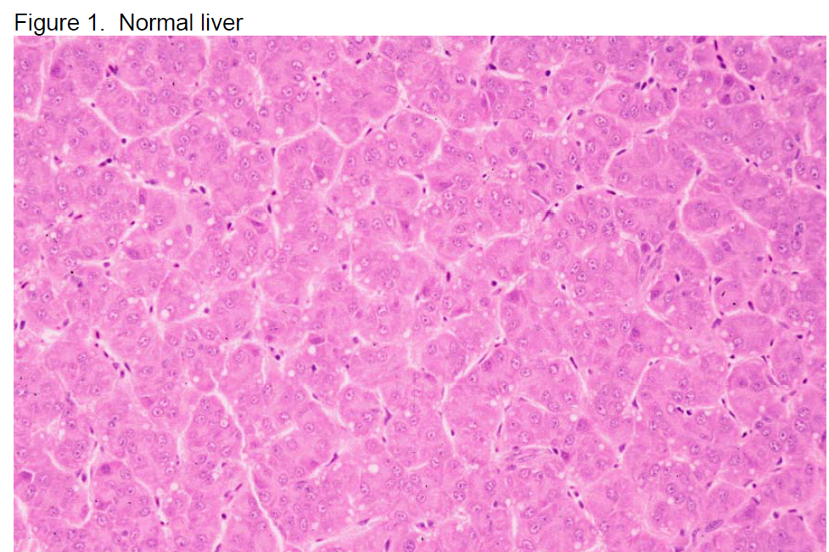

Slide 5
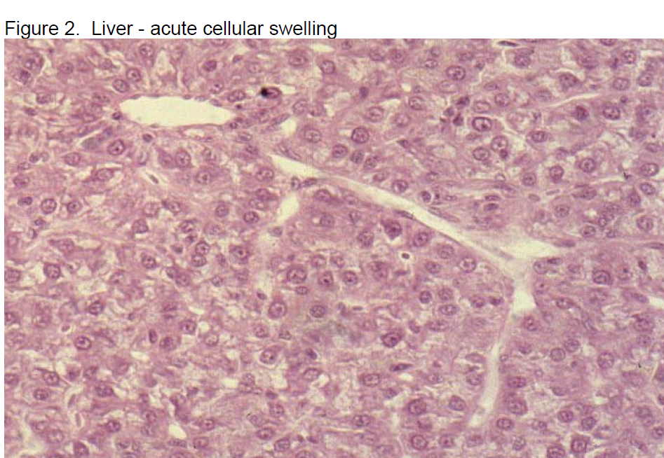

Slide 6
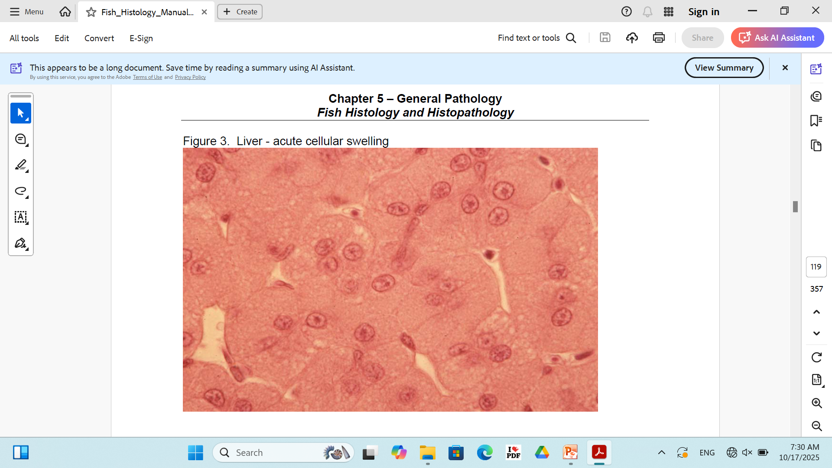

Slide 7
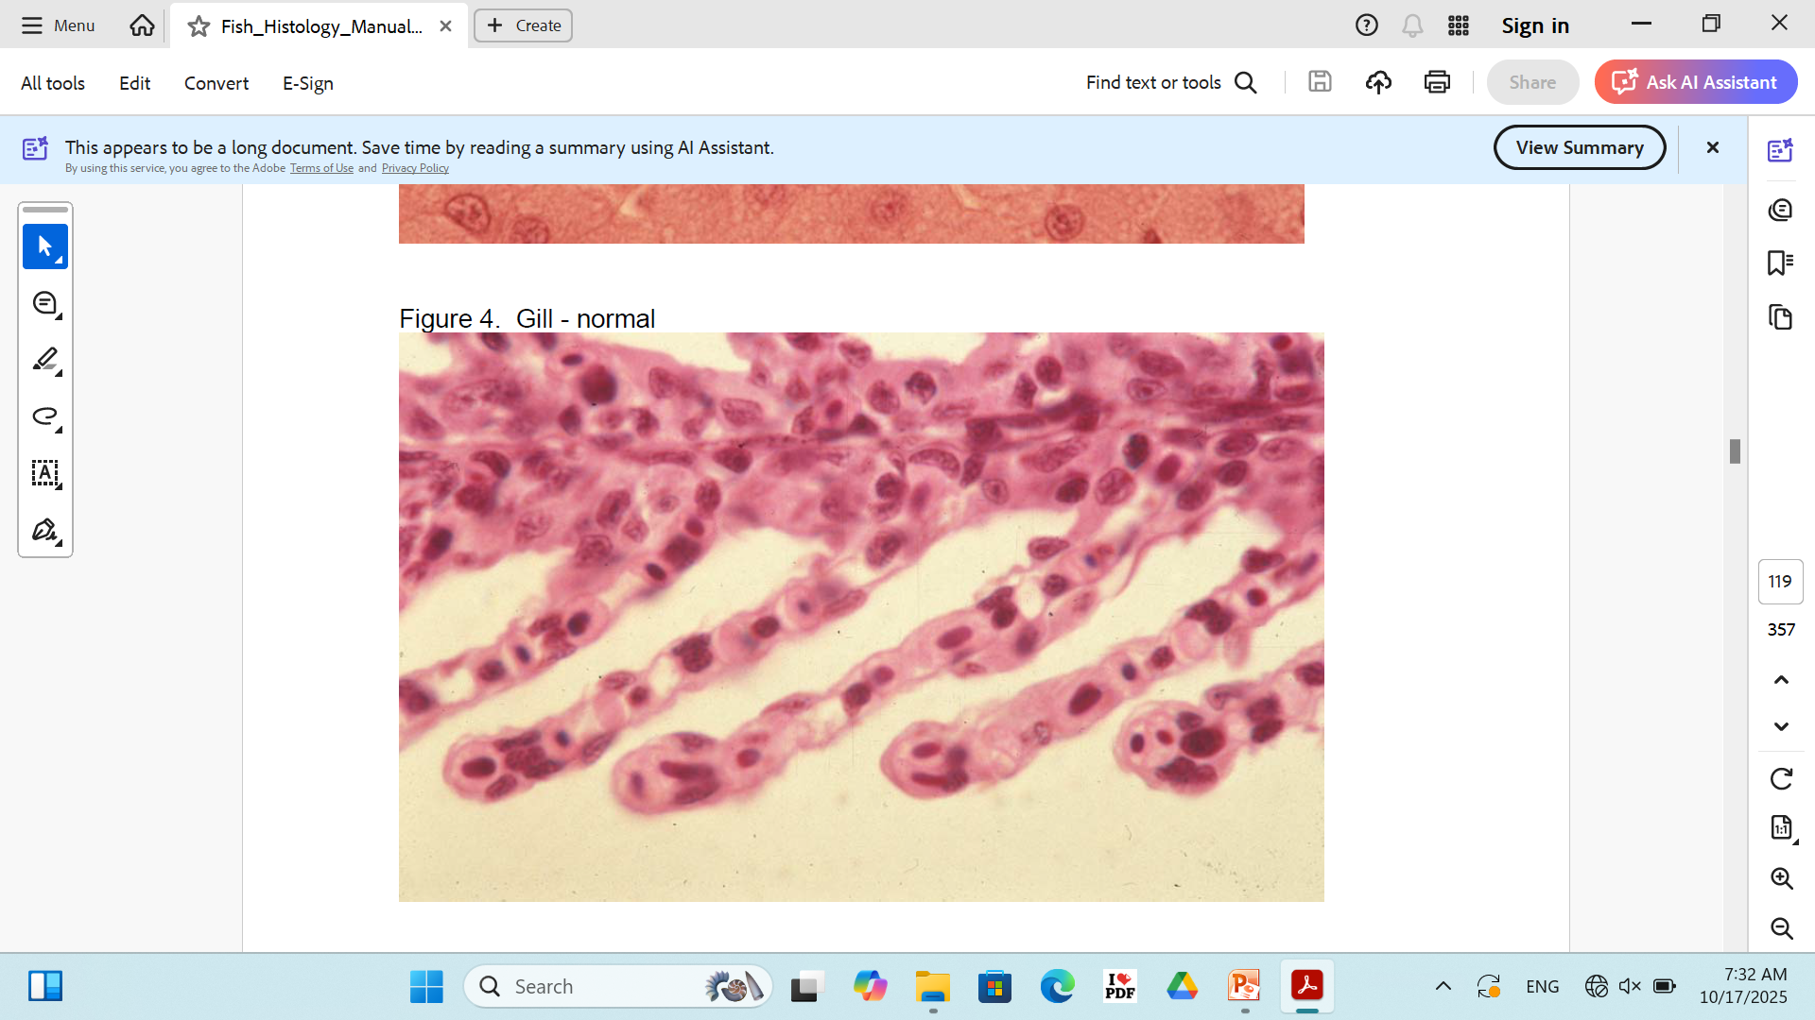

Slide 8
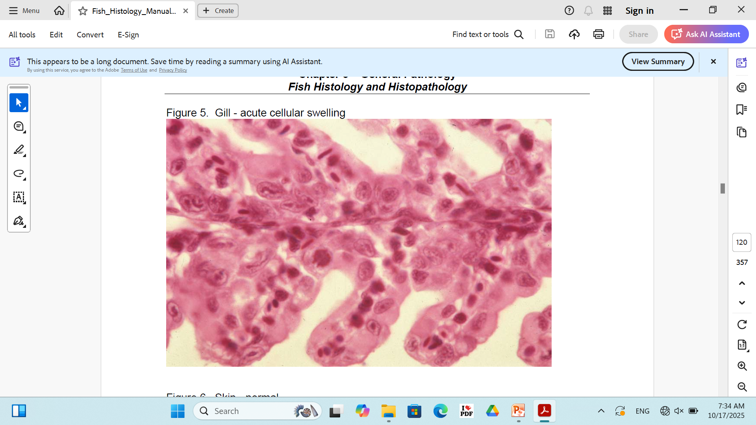

Slide 9
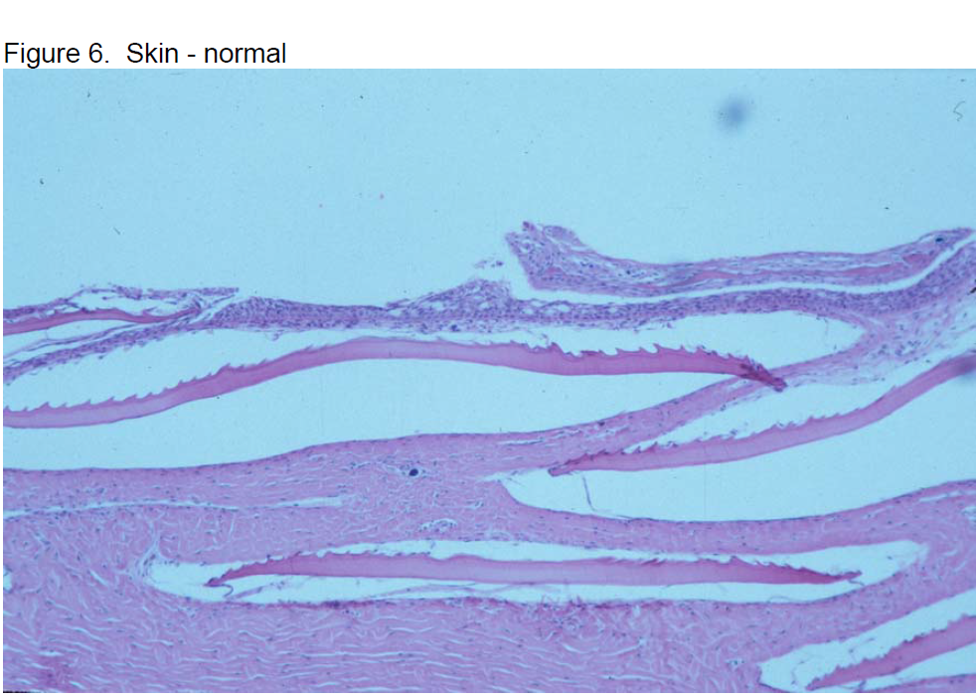

Slide 10
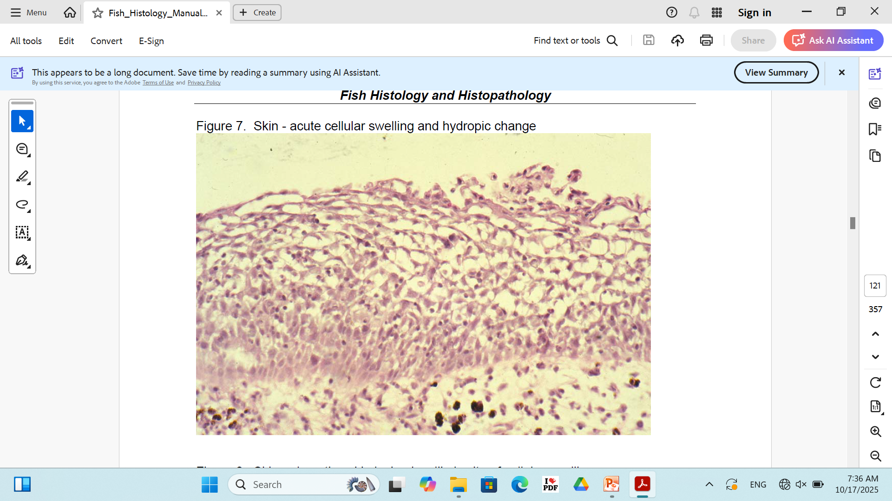

Slide 11
2- Hydropic change
Large distinct water vacuoles form within the cell cytoplasm. It is a more pronounced from of swelling than acute cellular swelling.
Small vacuoles coalesce, giving a clear vacuolated appearance to the cytoplasm. Water is located in
mitochondria and within cisterna of endoplasmic reticulum. Again, epithelium is a frequent target.

Slide 12
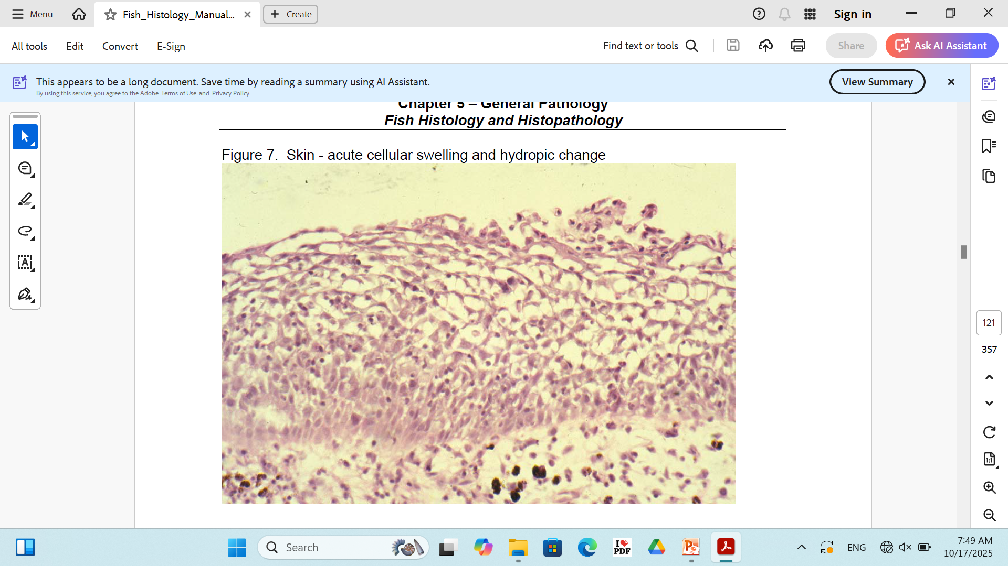

Slide 13
3- Fatty Change
Fatty change (fatty metamorphosis; lipidosis) is an abnormal and excessive accumulation of intracellular fat. It is most commonly seen in the liver, but also seen in kidney and heart.

Slide 14
Mechanisms that excess fat accumulation in a cell.
dietary excesses of carbohydrates or triglycerides.
decreased oxidation of fatty acids leading to increased esterification of fatty acids to triglycerides.
decreased lipid acceptor protein (hypoxia, deficient dietary protein).
dietary protein - fat imbalance.

Slide 15
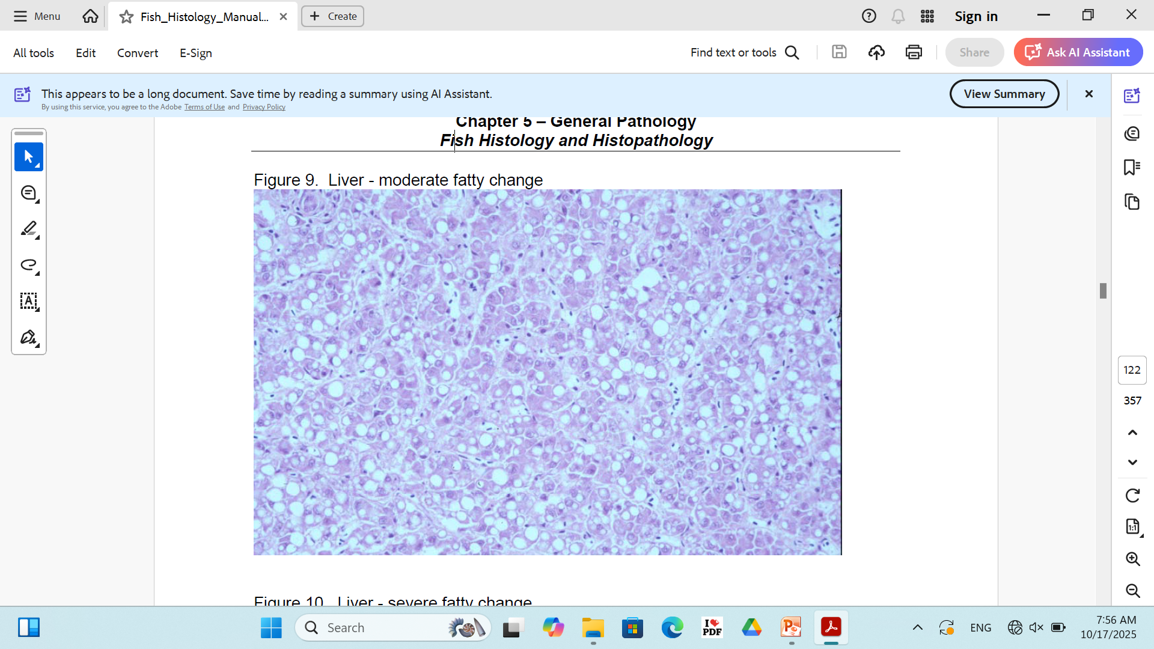

Slide 16
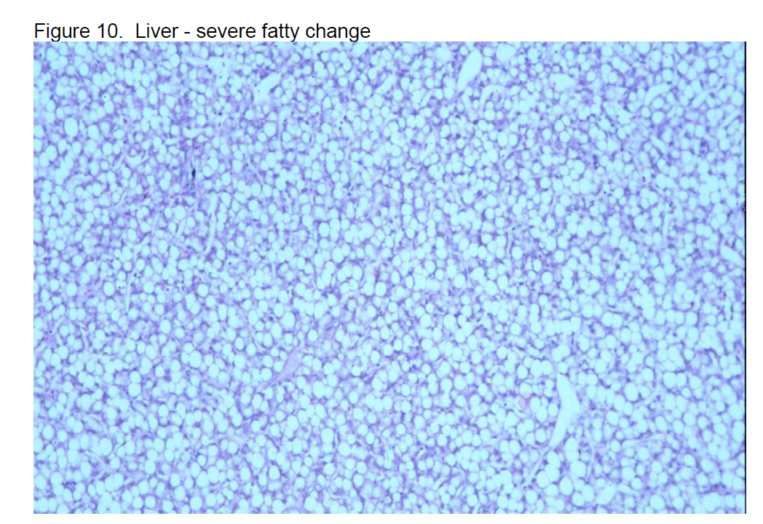

Slide 17
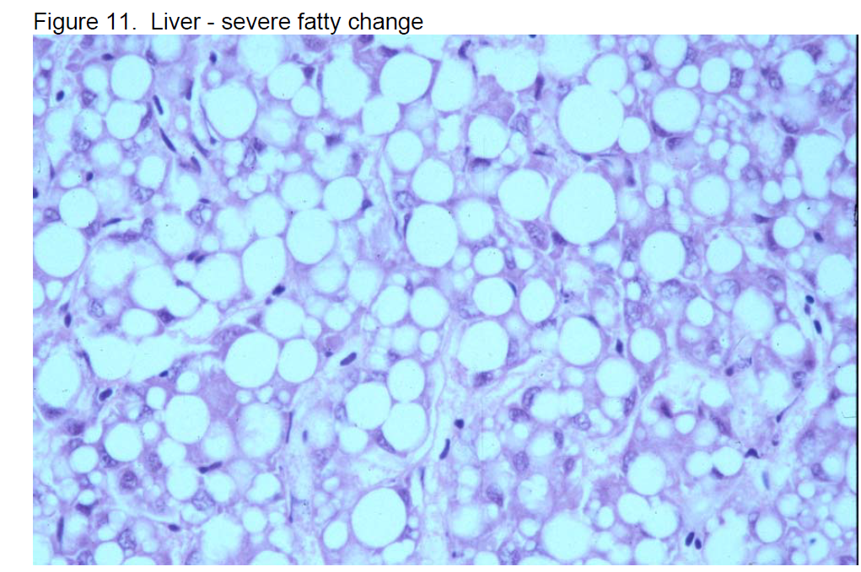

Slide 18
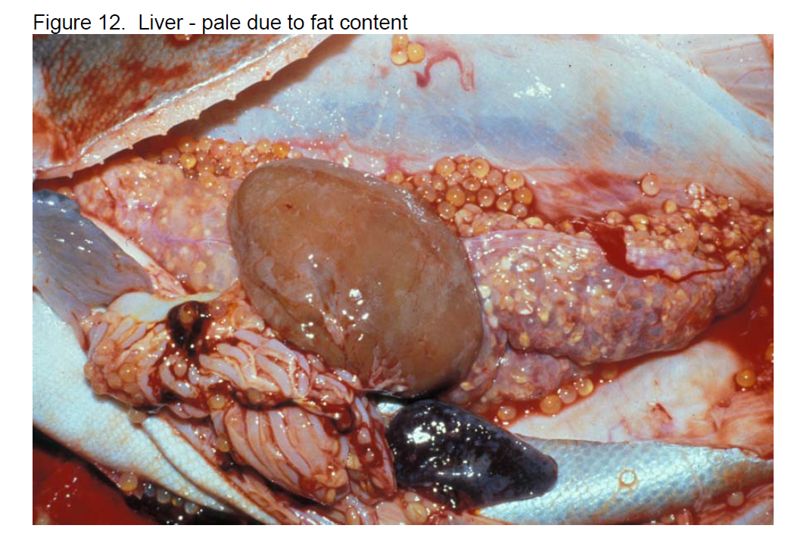

Slide 19
4. Hyaline change
Hyaline material is dense, amorphous, homogeneous, and eosinophilic.
Found under normal or pathologic conditions, and may or may not be reversible. It can represent an accumulation of material within the cell, or occur as a result of cell degeneration.

Slide 20
Necrosis
Cell injury can progress to a point of no return, where the cell is unable to adapt and homeostasis is no longer possible. Irreversible injury occurs and cell death.
Necrosis: The premature death of living tissue, resulting from injury infection or disease.
***Major disruption of the cell membrane occurs during necrosis, accompanied by massive influx of calcium into the cell.

Slide 21
Signs of Necrosis
1. Pyknosis
2. Karyorrhexis
3. Karyolysis
The cytoplasmic features of necrosis include:
intense eosinophilia
loss of basophilia, and fragmentation or hyalinization of the cytoplasmic component.
In addition to these cytological features, necrosis will induce localized inflammation
(assuming death does not occur to quickly).

Slide 22
Types of necrosis
1. Coagulative necrosis: is characterized by retention of cellular/tissue architecture; cellular detail is retained in the face of cell necrosis. This is associated with diverse causes, including many infectious diseases, ischemia, burns, trauma, and toxic damage.

Slide 23
2. Caseous necrosis: is more easily recognized grossly; they have a dry, cheese-like consistency. Histologically, there is no cellular detail. Mineralization is common.
*** This is seen with some bacterial infections.
3. Liquefactive necrosis: features complete disintegration of the tissue into a liquid of varying consistencies.
*** All histologic features are lost.
The liquefaction is caused by enzymes released from host cells, such as neutrophils or other inflammatory cells, or by toxins released from bacteria.
Necrotic cells are dead and they will not recover.

Slide 24
4- Fat necrosis
Release of activated pancreatic lipase. Liquefy the membrane of the fat cells of peritoneum.
Lipase is breaking the triglyceride ester, which bind with calcium in process called saponification

Slide 25
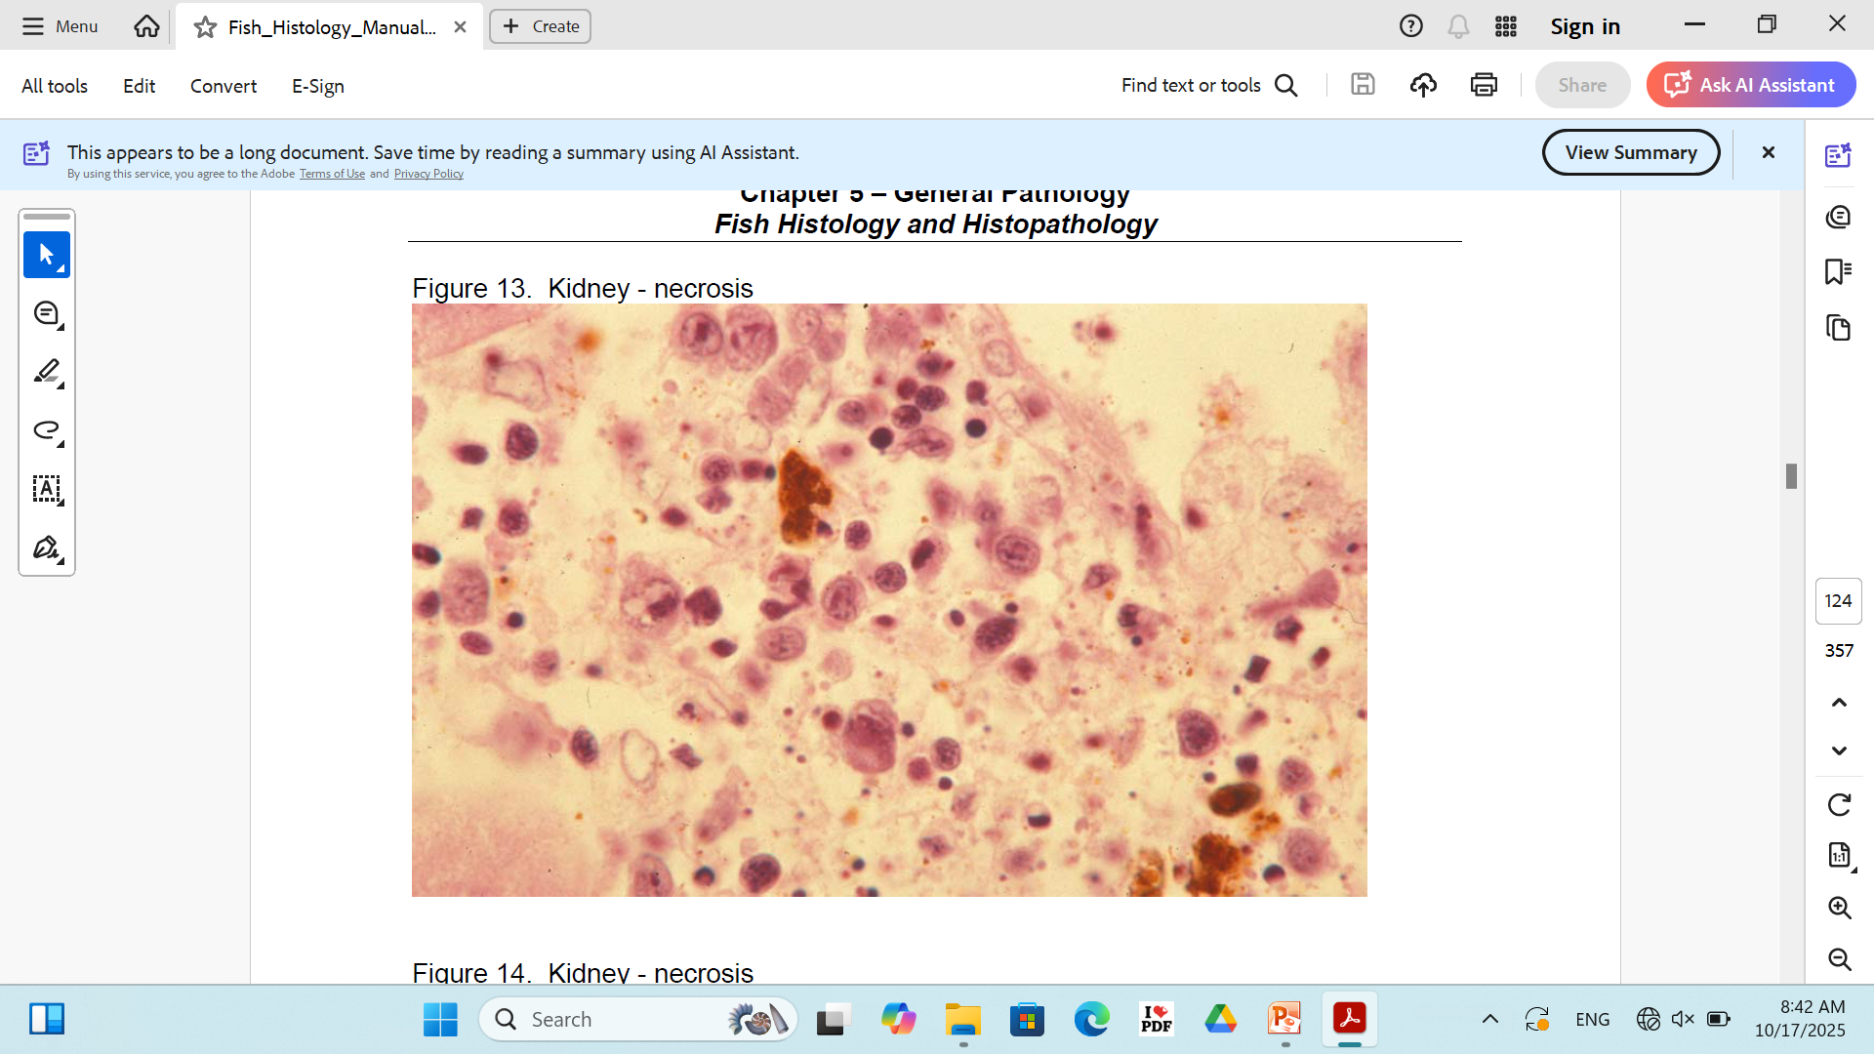
Coagulative necrosis

Slide 26
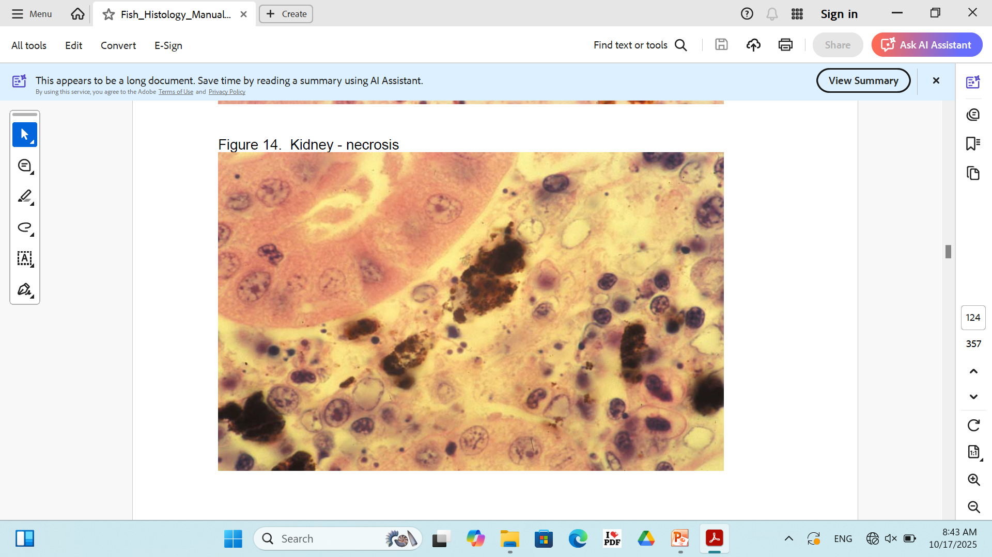
Coagulative necrosis

Slide 27
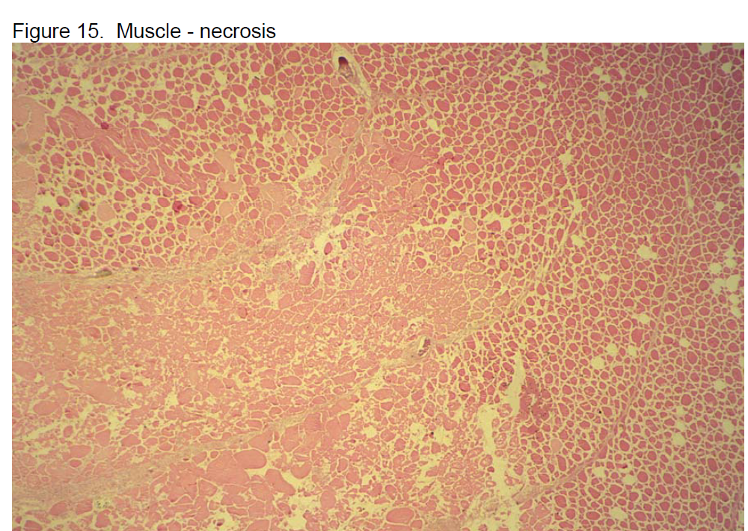
Coagulative necrosis

Slide 28
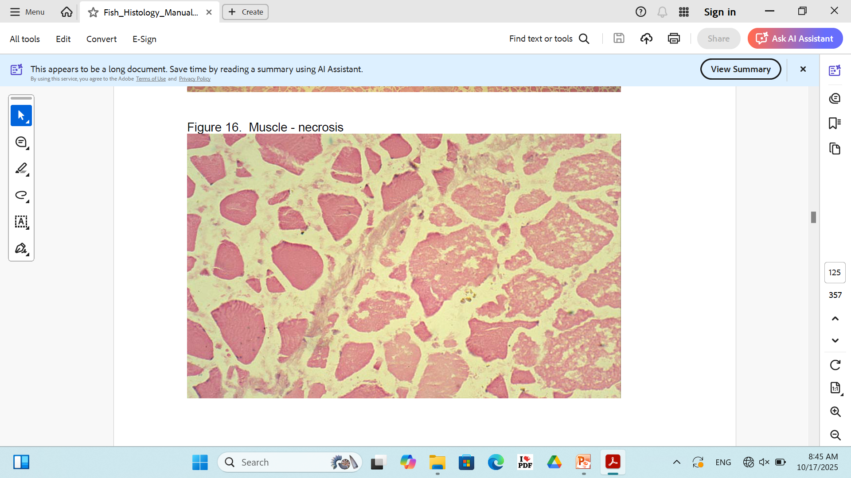
Coagulative necrosis

Slide 29
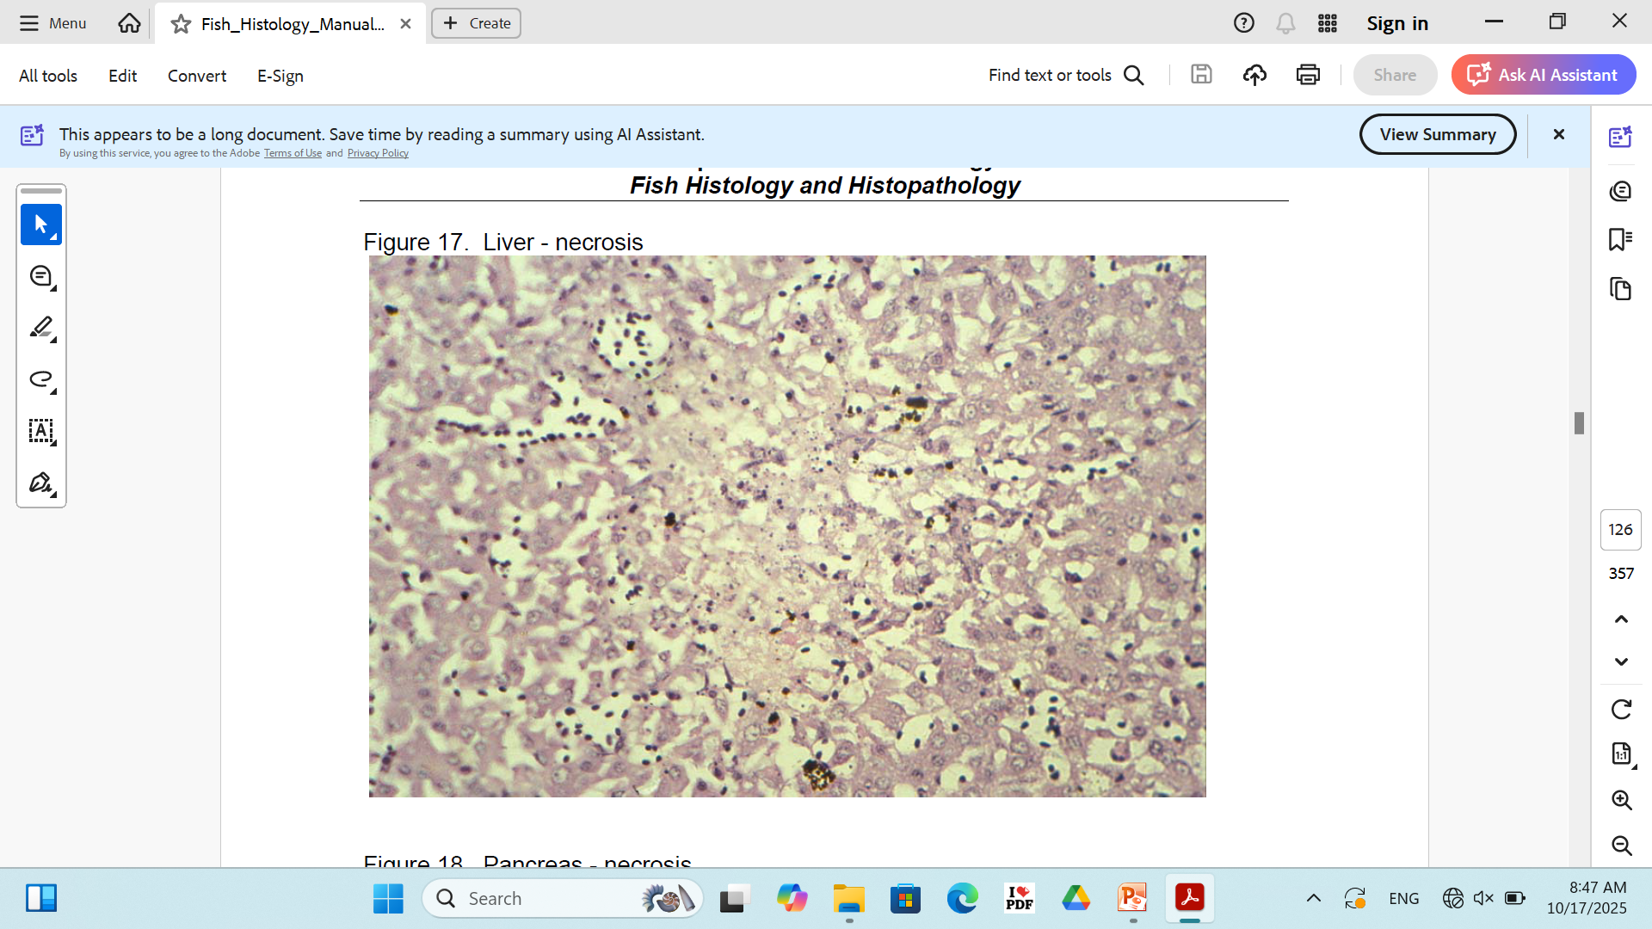
Liquefactive necrosis

Slide 30
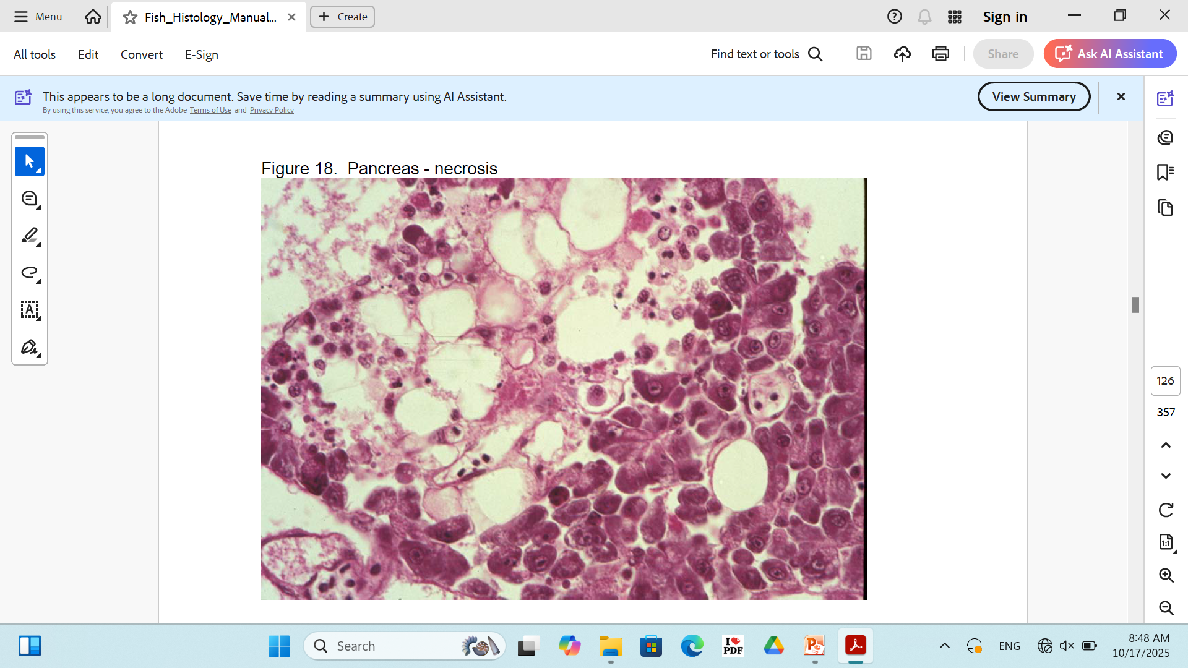
Fat necrosis

Slide 31
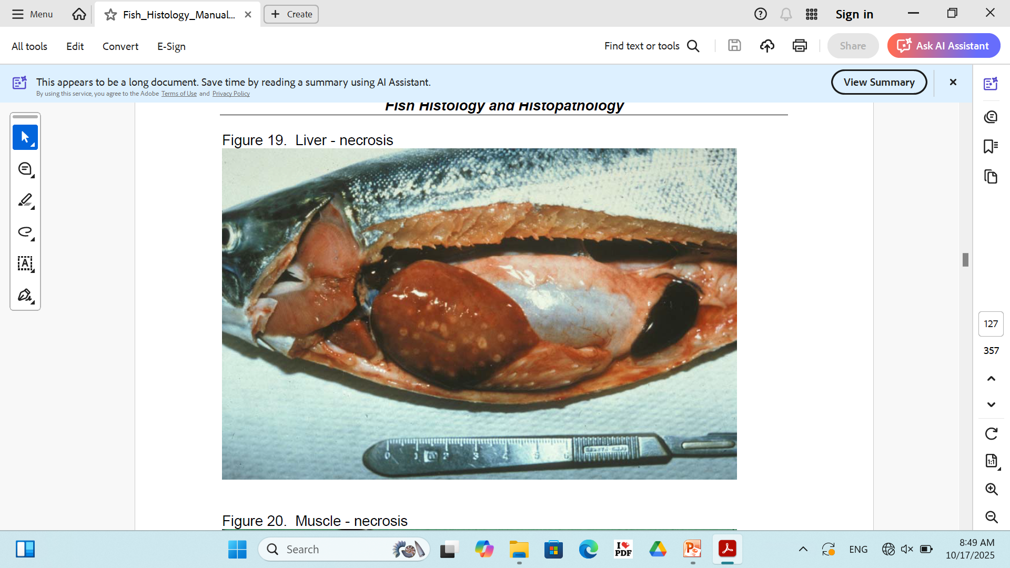

Slide 32
